Slide 1
Client Meeting Week 5

Slide 2
Tech Limitations
Tech | Benefits | Problems | Tech Per Object
Apple AirTags | - Mobile - Out of the box | - 5Hz - One tracker per phone | 4 trackers and 4 phones
ALPS | - Supported by ETC - 60Hz | - Only gives position - Have to mount a phone | 2 phones
AprilTags | - Cheap - works on any camera - Can track many objects | - Rotation stutters - Requires line-of-sight | 1 camera (and paper tags)
Azure Kinect | - Realtime 3D reconstruction | - Max range is 15ft - Requires line-of-sight | 1 camera
Vive Trackers | - Very accurate - Integrated with SteamVR | - Object has unnatural geometry - Requires line-of-sight | 1 tracker (and 2 base stations for all)
Notes:
What feature they are offering

Slide 3
Tech Limitations - Summary
All tech alternatives have serious downsides
Rule out:
AirTags - low refresh rate
Azure Kinect - low effective range
Of the remaining three:
AprilTags - low cost, medium accuracy
ALPS - high cost, high accuracy
Vive trackers - low cost, high accuracy
Most cost effective is Vive trackers
May change when ALPS tags are released

Slide 4
Material Change

Slide 5
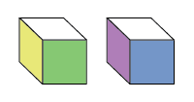
Otrex
(Object Tracking Exploration)
A study of networked object tracking interaction

Slide 6
Study Goals
Object parameters: How can an object be used as a controller? (UX Design)
System limitations: What are the strengths and weaknesses of different tracking methods for different situations?
Speed vs accuracy
Set-up/tear-down
Inconspicuousness
Devise a series of exercises to test the above questions.

Slide 7
Health and Safety
Safety:
Health and Safety Warning, like Space Pirate Trainer.
“...treat this like exercise… rest between levels…”
The ground must be clear of tripping hazards
NO THROWING OBJECTS!!
Art/Visual:
Mapping of object must be 1:1
Unobtrusive - Does not obscure the shape of the object
Potential for particle effect over the object

Slide 8
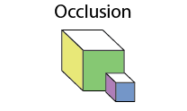
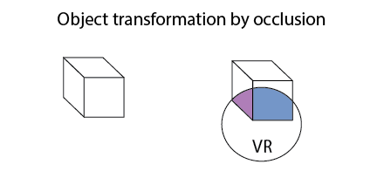
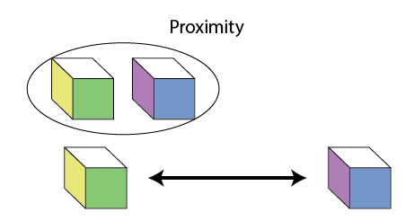
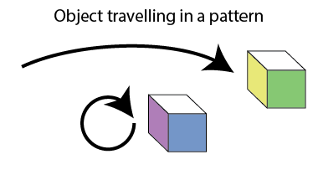
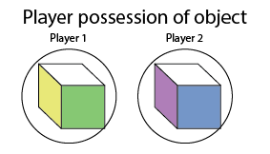
Object functions
Object/player proximity
Distance traveled by object
Object traveling in a pattern (arc, circle, glyph)
Object in possession of player
Object transformation based on position/occlusion

Slide 9
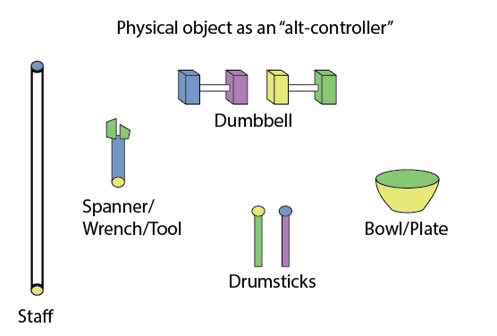
Objects as alt-controllers
Objects that could be gamified and shared, working as an alternative controller (alt-controller). The method of tracking would affect the complexity of the object.
Staff
Tool
Dumbbell
Bowl/Plate

Slide 10
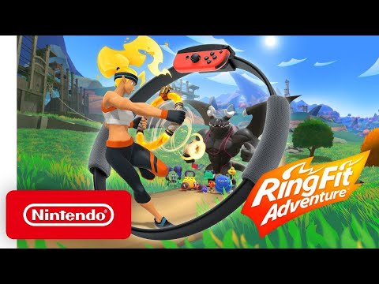
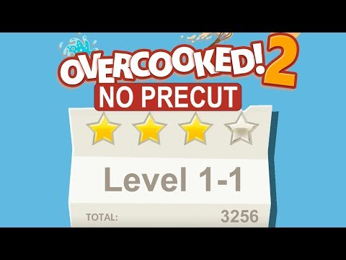
References

Slide 11
Game concepts based on object interaction
Dumbbell - Turn based combat, using different movement patterns to perform actions/attack
Strength/endurance used effects power level in game.
Benefits of turn-based game would mean the “on-screen” pace is slower, not so hard on real time tracking, not so chaotic. (ref. Spin Fit Adventure)
Magic staff - An object reacts in a different way depending on which player is hold it.
A large monster in the center of the room, players must move around sides, critical weak points that must be hit with particular elemental combinations, depends on players working together and coordinating who gets which staff.
Bowl/Plate - Frenetic object sharing and location/interaction based progression of a process.
Object must be shared and manipulated by different players at different locations to add an ingredient to make a complete meal. (ref. Overcooked/Diner Dash)

Slide 12
Summary
Evaluating the pros and cons of different tracking methods
How people will use different props/objects
Safety Concerns
Giving people a reason to move around this space and handle/share objects

Slide 13
Space Crew
A Multiplayer MR experience in the spaceship.

Slide 14
Experience Pillars
Big Room
30 * 30 Space
Free to walk
COOP
Different Tasks
Same Goal: Survive
Mixed Reality
Tracked Object
Passthrough Camera

Slide 15
How to define COOP
Same Goal
Maintain the Spaceship
Survive in the Spaceship
Different Events
Inside Factors
Broken parts
Outside Factors
Meteorite
Black Hole
etc
Different Solutions
Fly Away
Fire the Weapon
Fix the ship module
Allocate energy
Manage the Schedule
Different solutions of the same problem
Who do What?

Slide 16
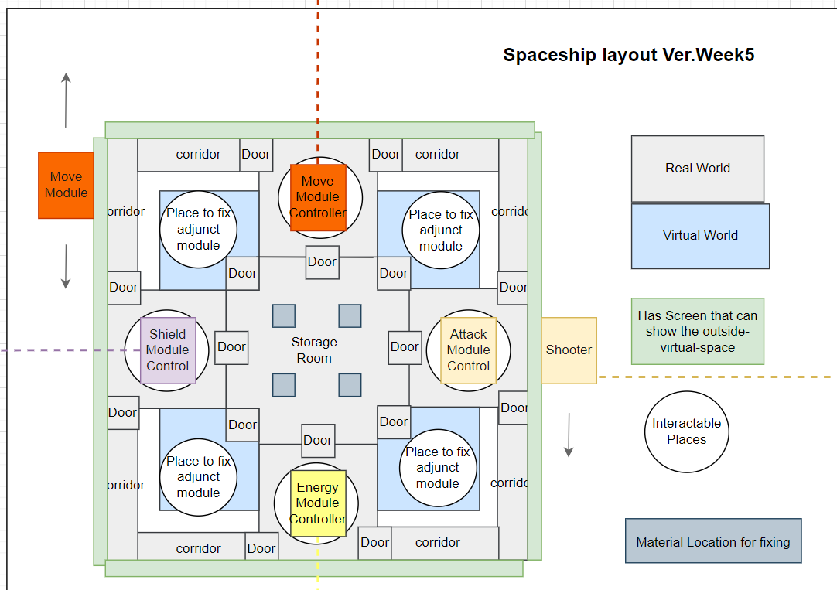
Spaceship Layout: Utilize the Big Room & Passthrough Camera
Notes:
VR World & Real World
VR World let players to fix adjunct module in the “Space”
Real World Prop to control the ship, Passthrough Camera with AR feature to enhance the control
Surrounding Screen to show the Space

Slide 17
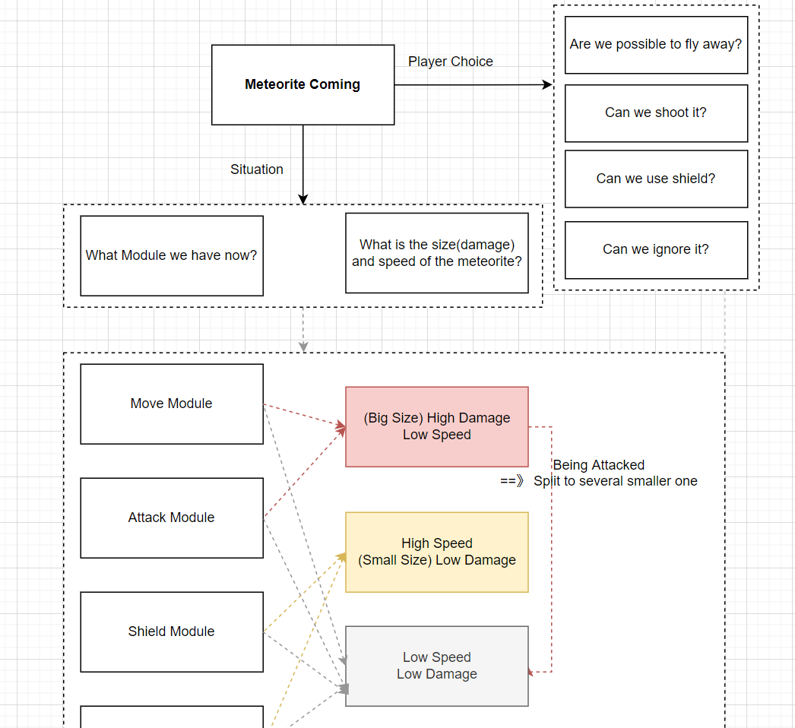
Different Solutions to the same problem
Notes:
Based on situation
What is the event?
What module is available?
What will different actions cause?

Slide 18
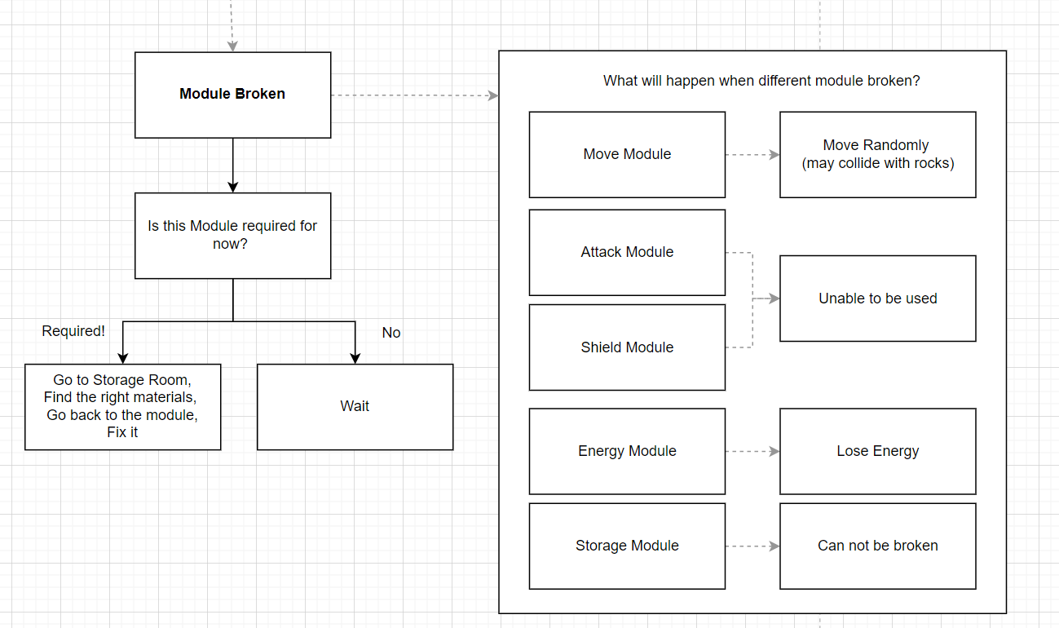
Different Solutions to the same problem

Slide 19
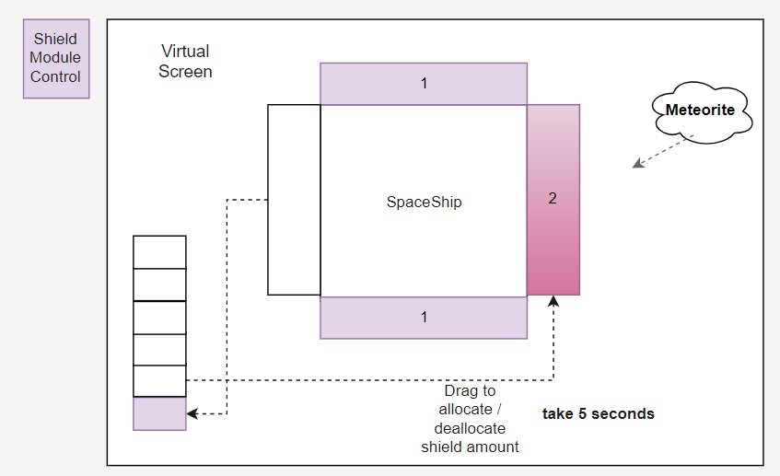
Shield Manage with Passthrough Camera & Virtual Screen in Real World

Slide 20
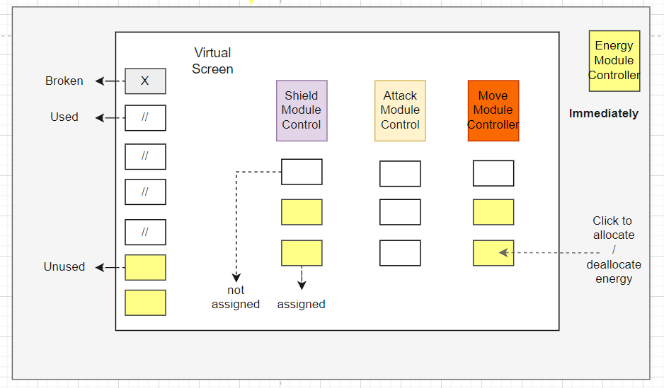
Energy Manage with Passthrough Camera & Virtual Screen in Real World

Slide 21
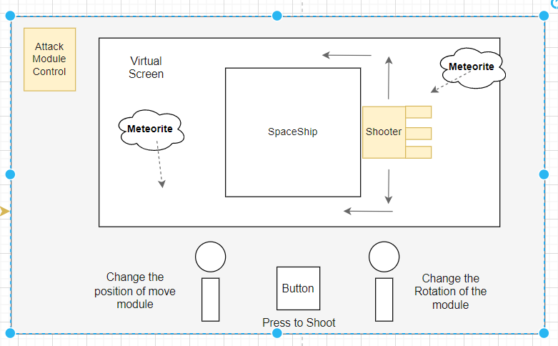
Shooting with Passthrough Camera & Virtual Screen in Real World & Physical Props

Slide 22
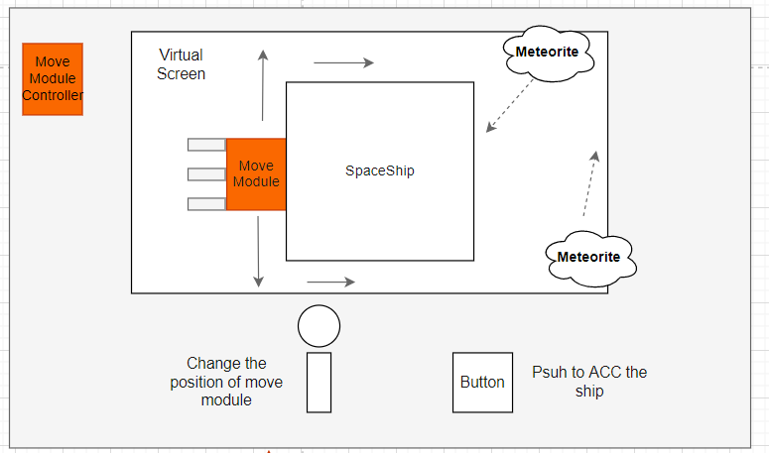
Moving the ship Passthrough Camera & Virtual Screen in Real World & Physical Props

Slide 23
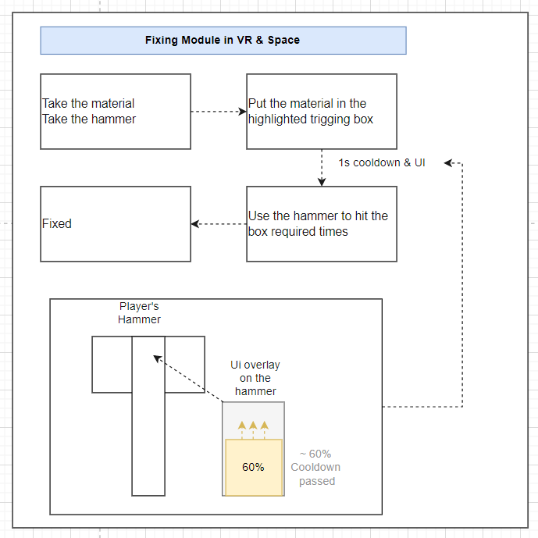
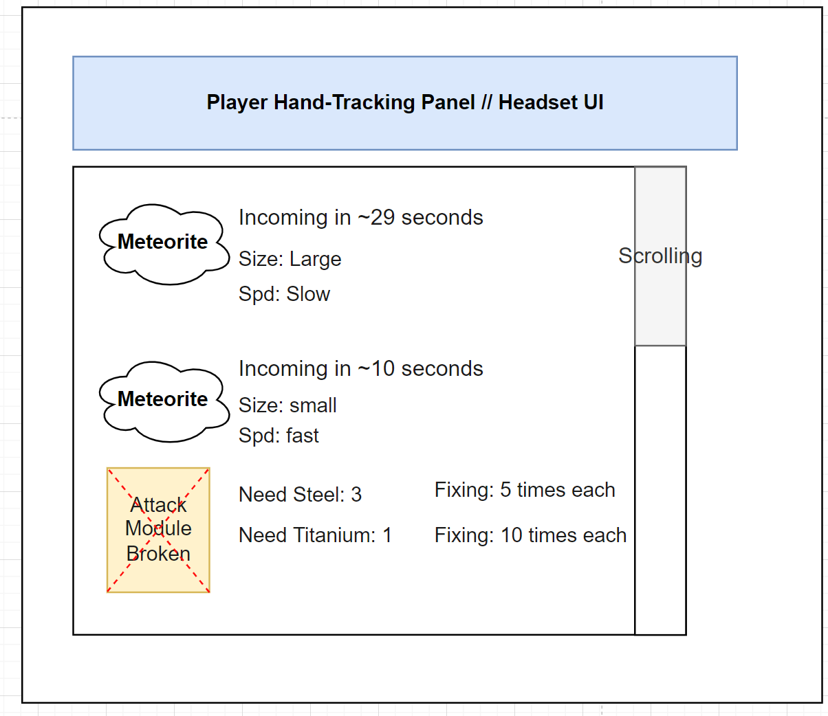
Fixing Broken Module in VR Space

Slide 24
Our Goal
Fully Utilize Big Room as a Spaceship
COOP gameplay
Immersive experience via Mixed Reality

